Slide 1

Exploratory Data Analysis
Analysis for XYZ
07/03/2020

Slide 2

Agenda
Executive Summary
Problem Statement
Approach
EDA
EDA Summary
Recommendations

Slide 3
Executive Summary
The Data combined from Cab Data Combined to cab data combined.
Primary keys
Cab_Data is Transaction ID →
Transaction_ID is Customer ID →
Secondary Key
Cab_Data is CITY
The data results will show that Yellow cab company is the most used cab company.
How it was combined into sqlite db using the commands in:
https://d.docs.live.net/ac174c4a849ab62f/Github/DataGlacer/Week_2_Create_Database.ipynb

Slide 4
Problem statement
XYZ is a private firm in US. Due to remarkable growth in the Cab Industry in last few years and multiple key players in the market, it is planning for an investment in Cab industry and as per their Go-to-Market(G2M) strategy they want to understand the market before taking final decision.
The datasets provided with multiple data sets that contains information on 2 cab companies. Each file (data set) provided represents different aspects of the customer profile. XYZ is interested in using your actionable insights to help them identify the right company to make their investment.
The outcome of your delivery will be a presentation to XYZ’s Executive team. This presentation will be judged based on the visuals provided, the quality of your analysis and the value of your recommendations and insights.

Slide 5
Approach
Investigate:
Which company has maximum cab users at a particular time period?
Does margin profit proportionally increase with increase in number of customers?
What are the attributes of these customer segments?

Slide 6
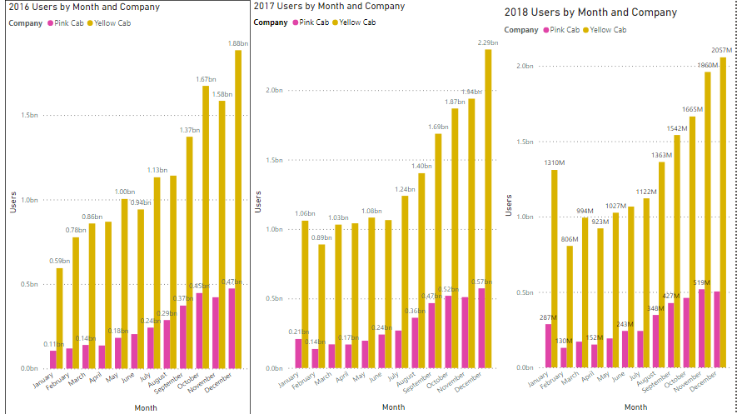
The company has maximum cab users at a particular time period.

Slide 7
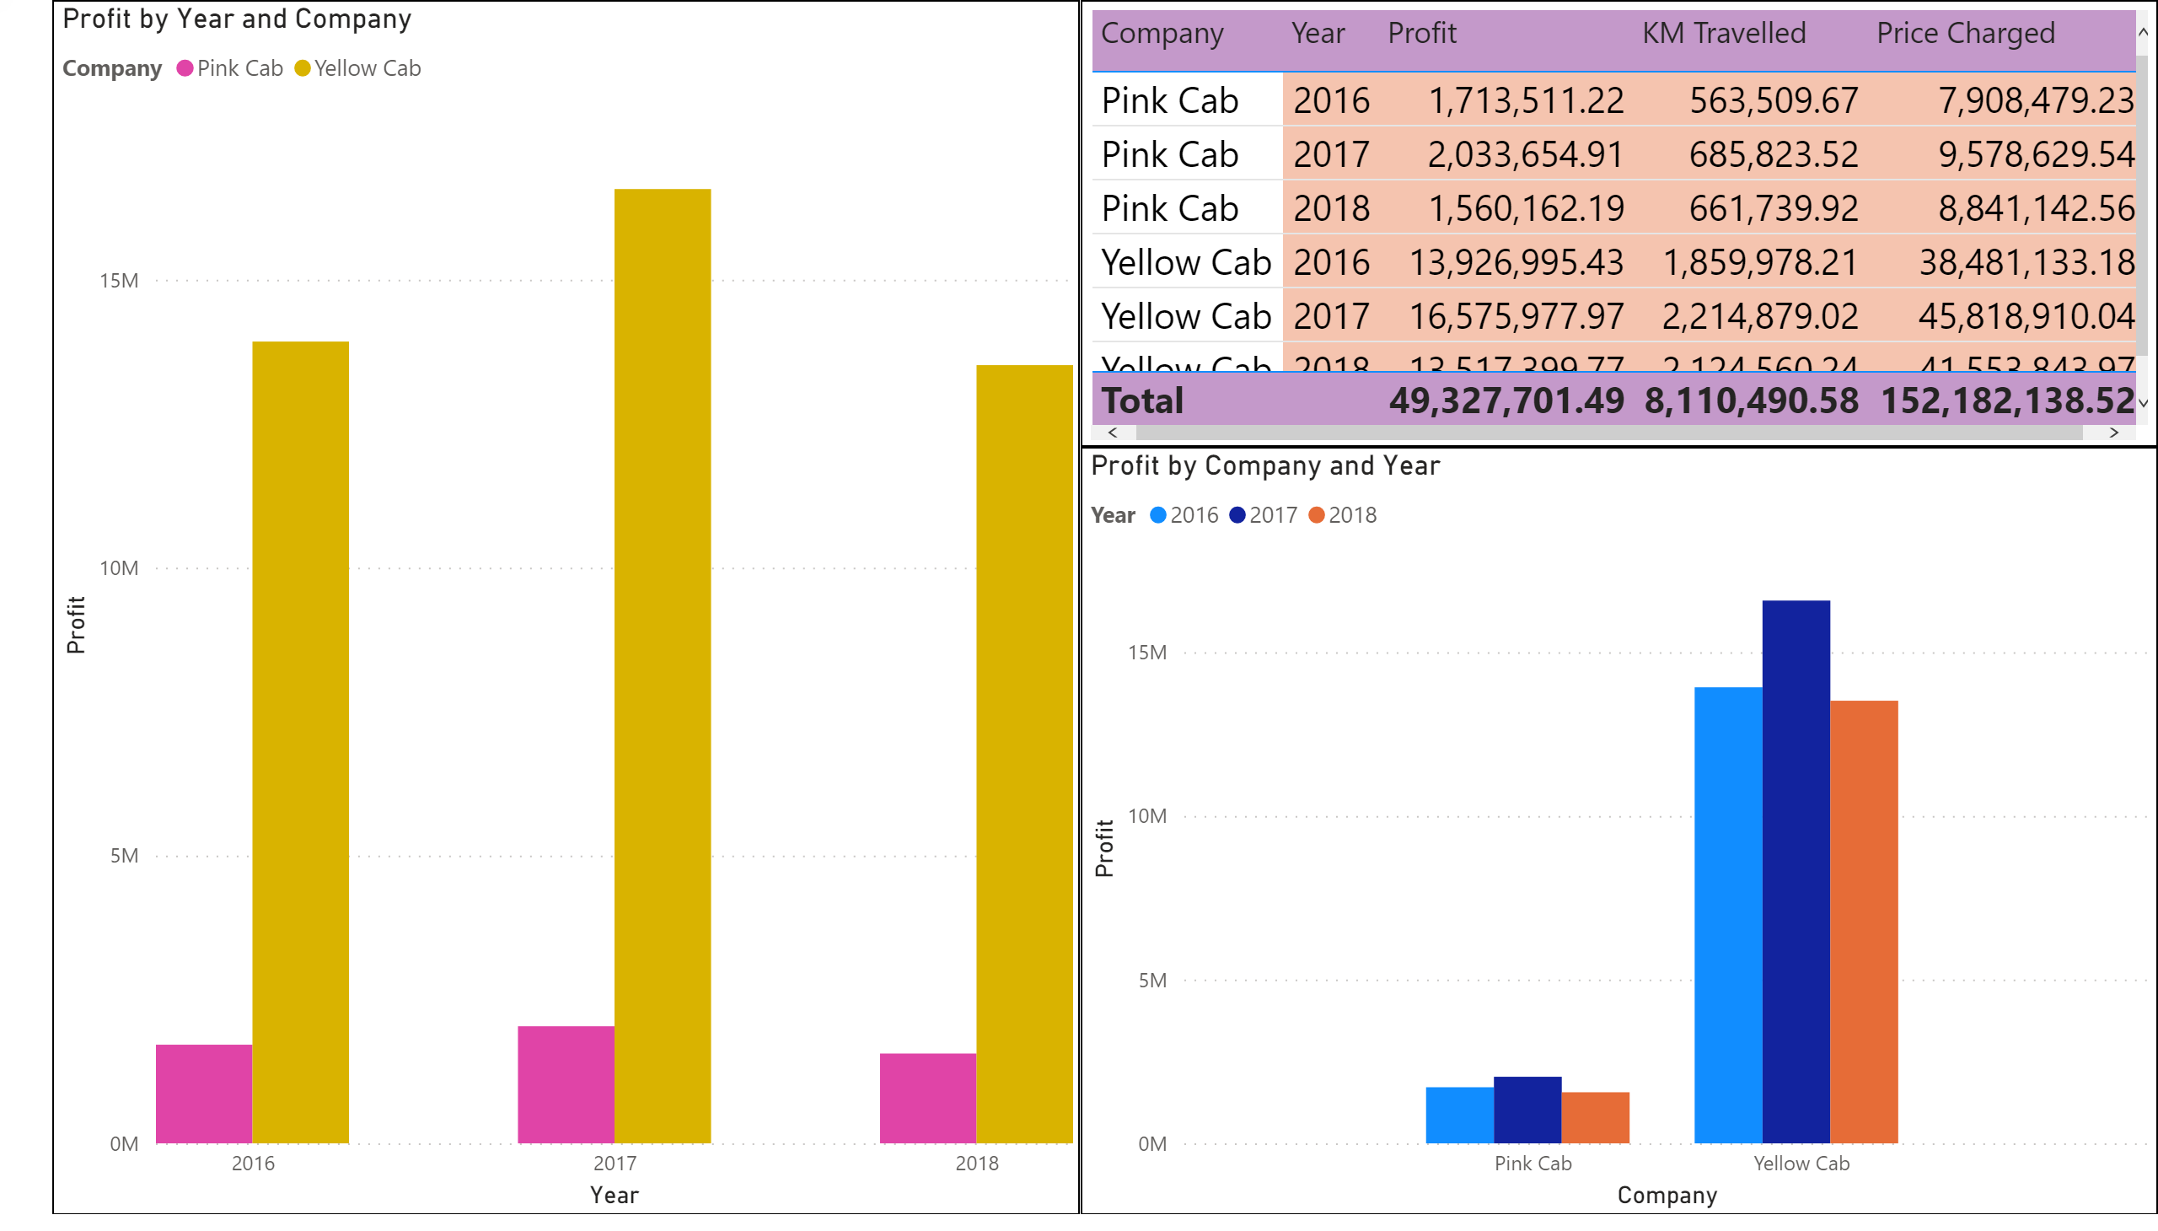
Profit Analysis : Profit per Company per year

Slide 8
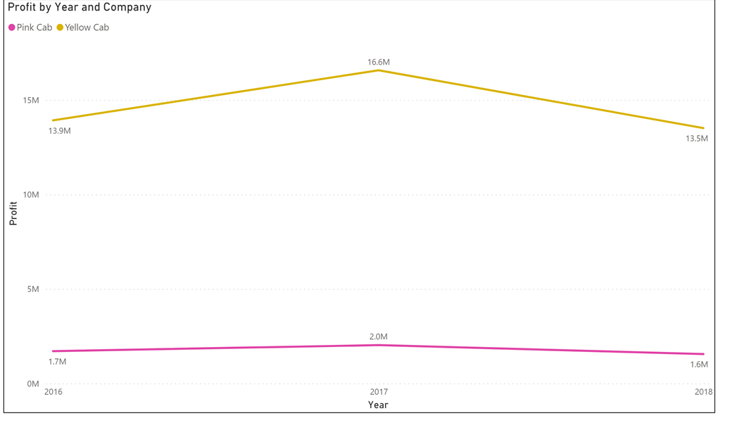
Profit

Slide 9
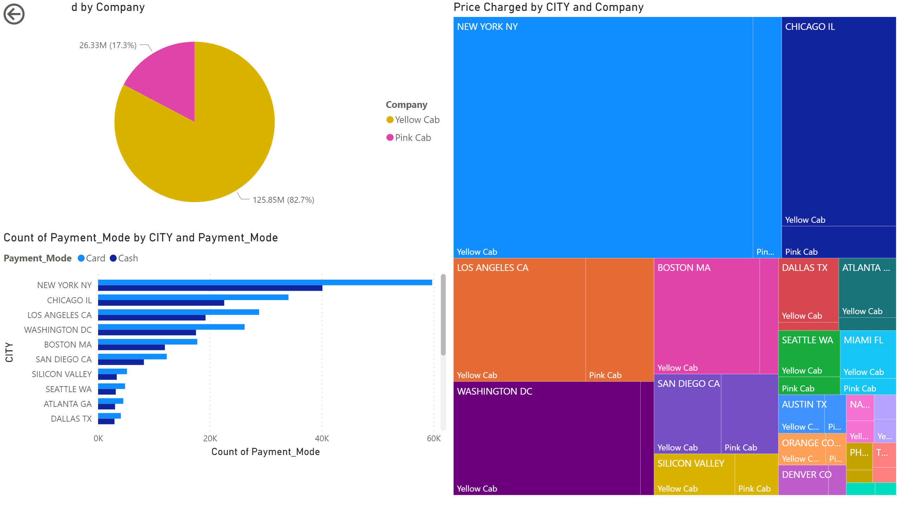
Preferred Payment method and Highest earning city

Slide 10
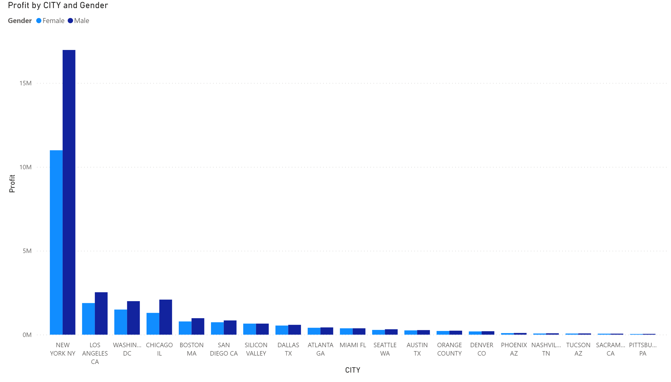
Profit by City and the Gender

Slide 11
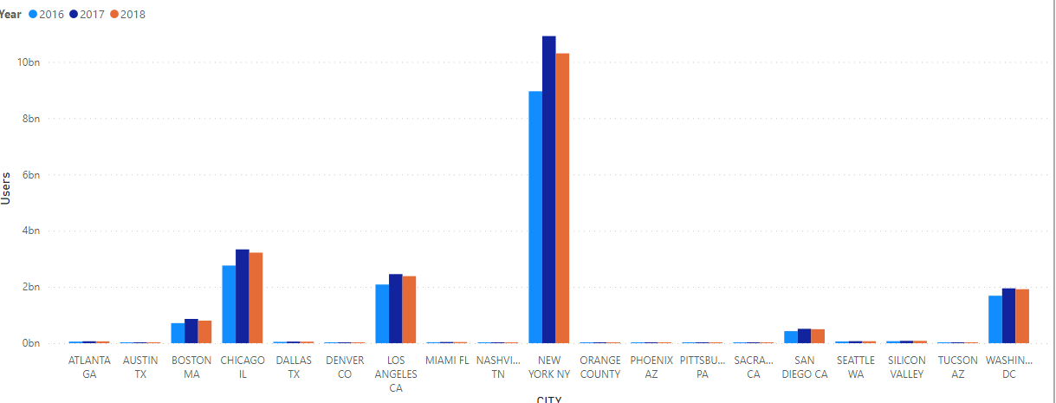
Cab users by city and year

Slide 12
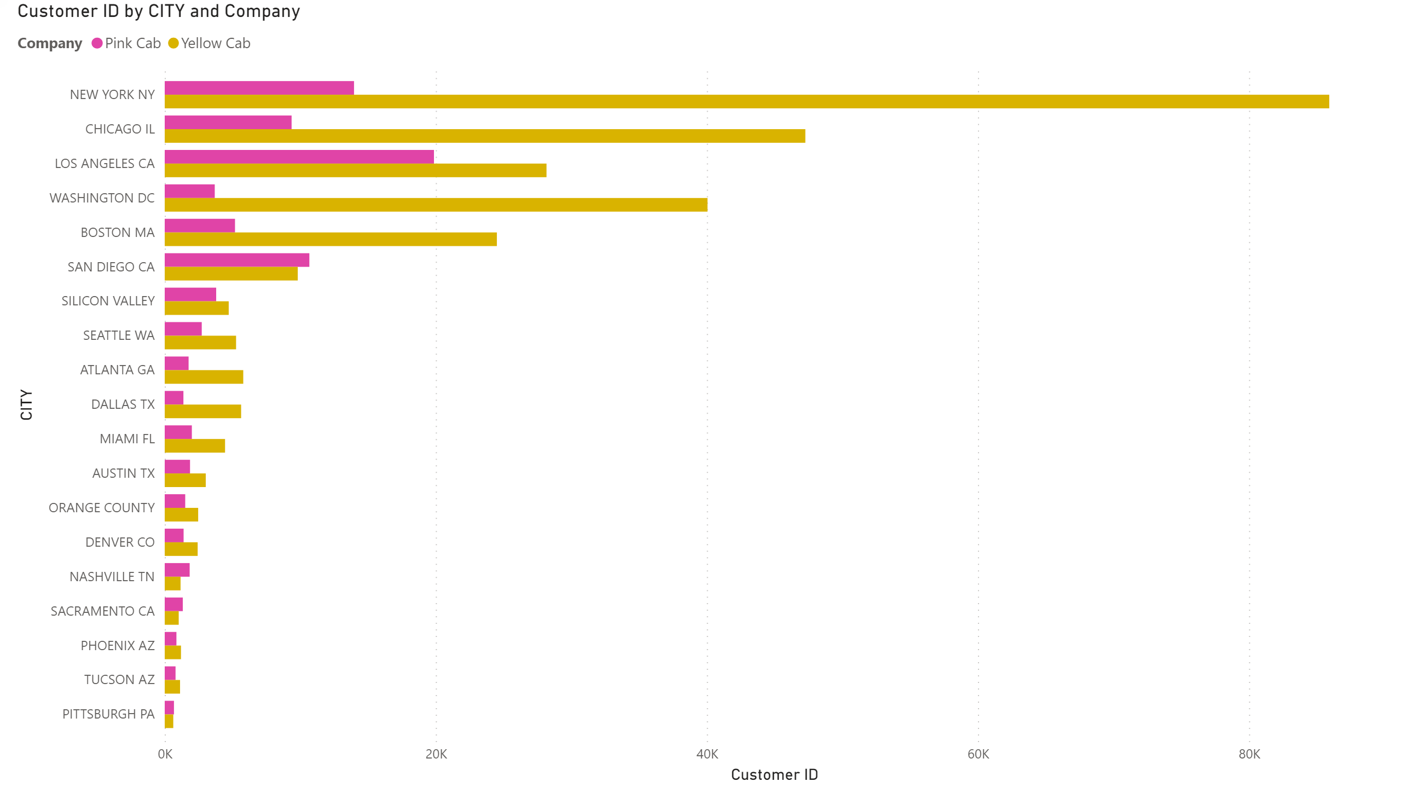
Customers by City and Company

Slide 13
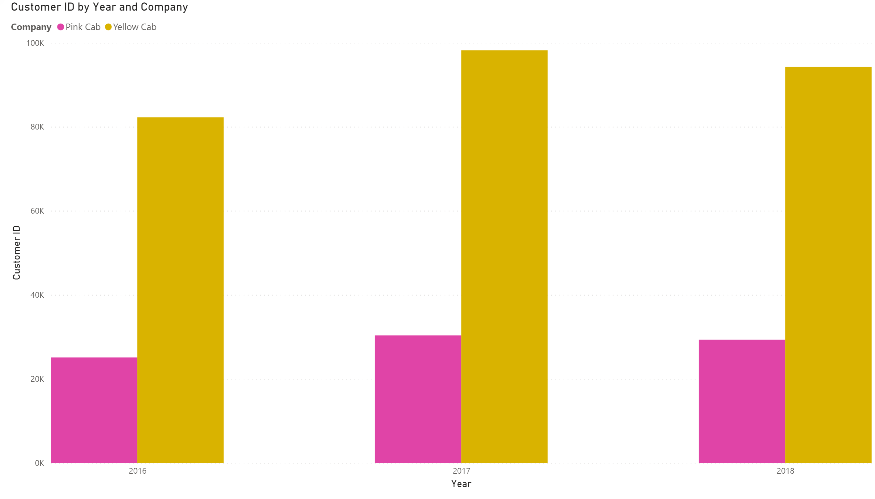
Customer by Year and Company

Slide 14
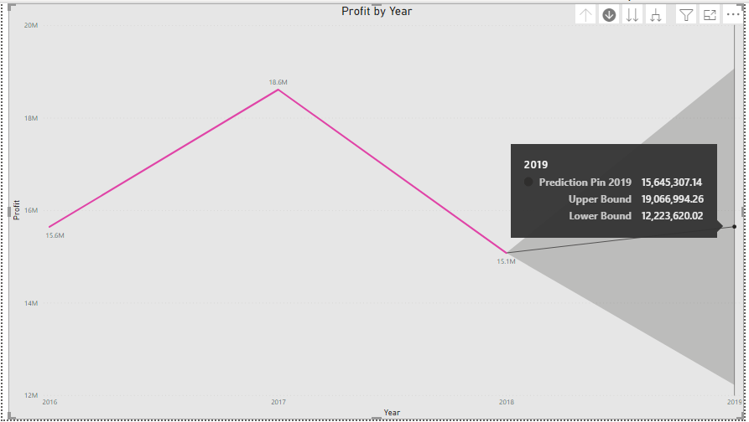
Predictions of Pink Profits for 2019

Slide 15
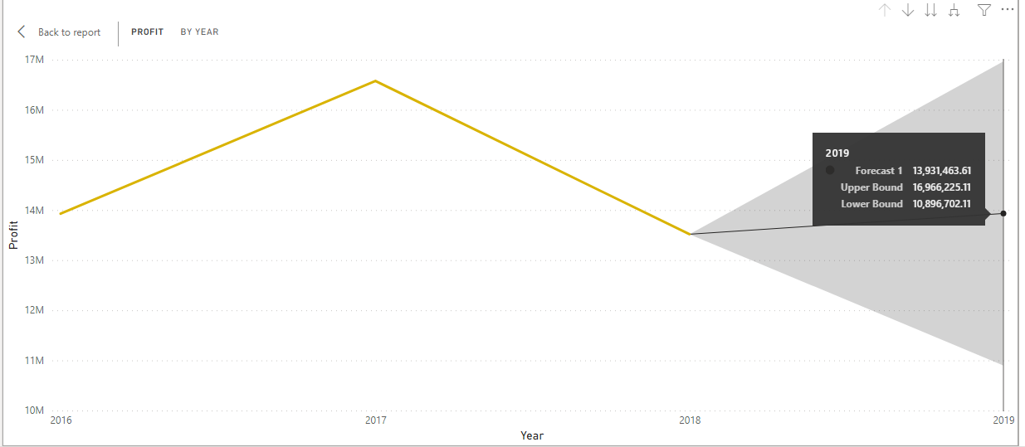
Predictions of Yellow Cab Company Profits for 2019

Slide 18
Summary
Yellow cab company is still the most popularly cab company on USA.
While the yellow cab company has prediction marginal profitability for 2019
Pink cab company has the ability to expand and take a greater market share

Slide 19
Investing in Pink cab company may give the best the return.
While yellow is a stable investment and can over time return a marginal investment .

Slide 20
Thank You

